Slide 1

Introduction to VLSI
Presented by :
Ramy Osama

Slide 2
Who am I ?
I graduated in 2020
I worked in Pearl Semiconductor for 4.5 years
I worked in Cisco for 1 Year
Linkedin: https://www.linkedin.com/in/ramy-osama-6845281b0/
Facebook: https://www.facebook.com/ramy.osama.77/
Number: +201003711797

Slide 3

Section agreement
Q1: Do you want us to stick exactly to the course content or Would you like to go one step further (UVM topics) ?
Q2: Would you like us to stick to using EDA playground or use Questa for simulation ?
Coding assignments shall be submitted using a git repo with a readme file on how to execute
Attendance will be filled in an excel sheet (Will depend on your honesty :D), You are free to leave if you are not interested
The section is based on interaction ask, ask, ASK!
My handwriting is soooo bad if you can’t recognize what I type just let me know.

Slide 4
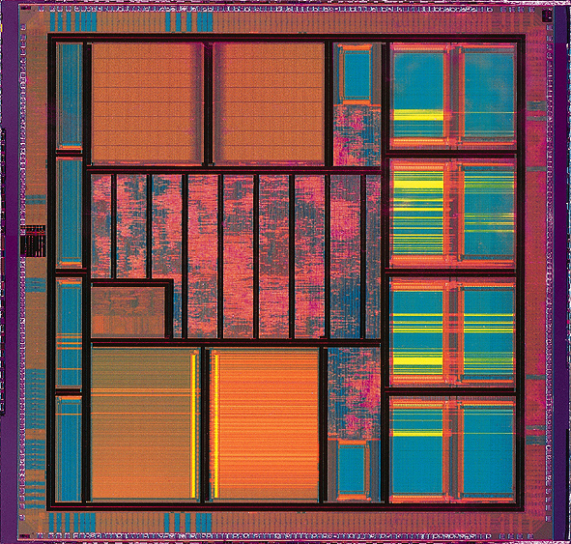
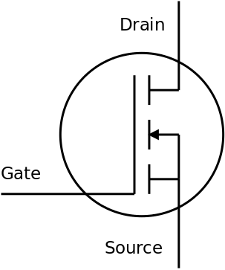
What is VLSI ?
VLSI (Very Large-Scale Integration) is the process of integrating millions to billions of transistors onto a single chip (IC).
Modern processors integrate billions of transistors using advanced CMOS technology

Slide 5
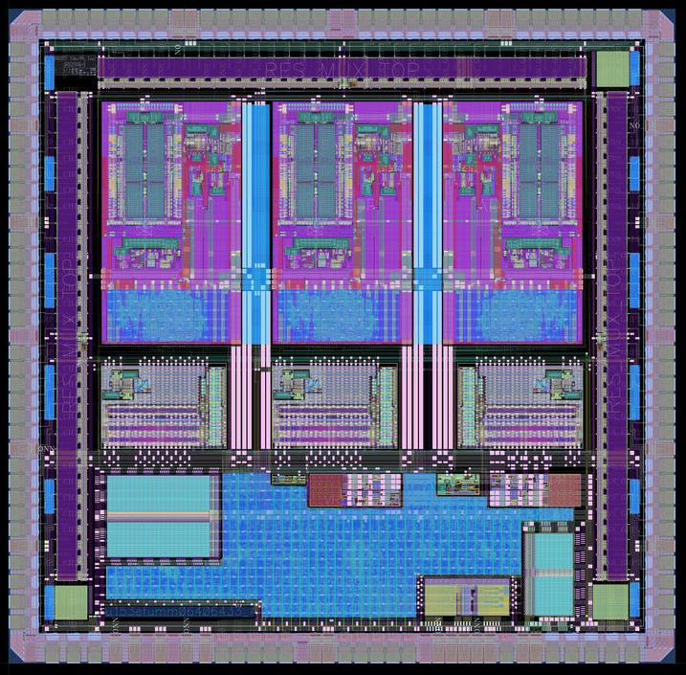
VLSI flow
System specification
Logic synthesis
RTL design
Physical design flow
Functional verification
Packaging and testing

Slide 6
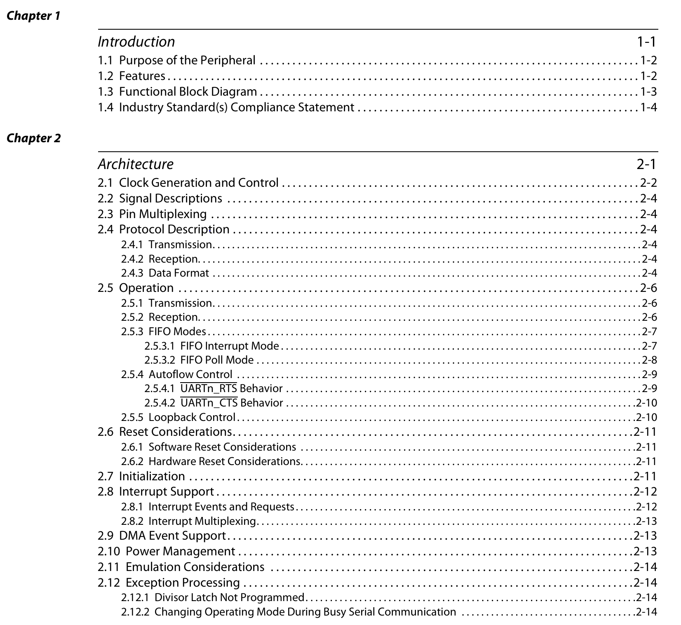
System specification
A System Specification is a formal document that defines:
What the system must do (functional requirements)
How well it must do it (performance requirements)
Under what constraints (power, area, timing, cost)
It is the contract between architecture, design, and verification teams.
This is an example for UART design specification datasheet.

Slide 7
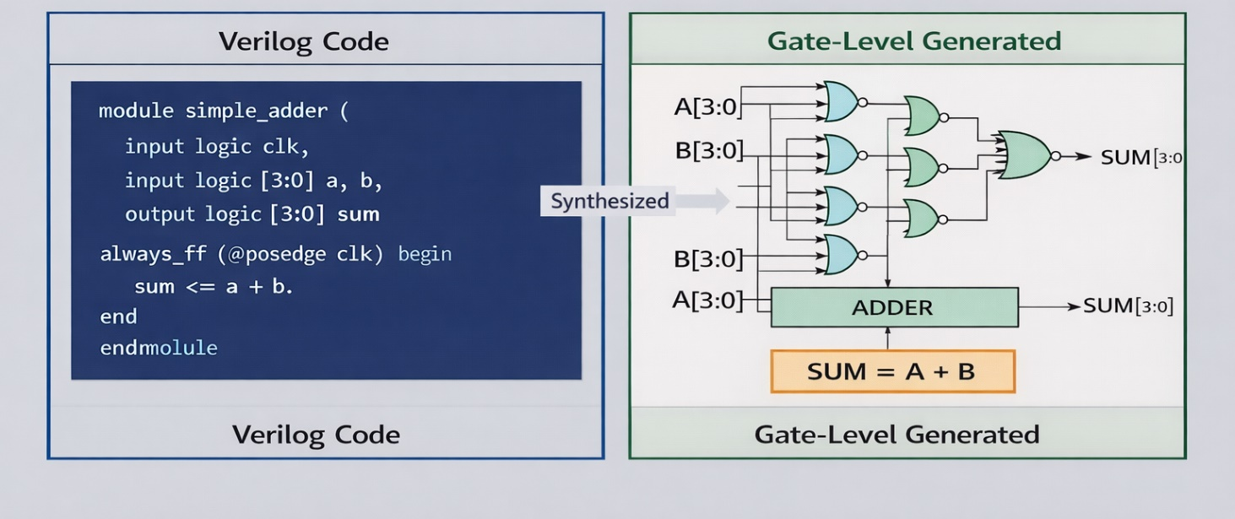
RTL design
Hardware behavior description using HDLs like Verilog or VHDL — defines how data moves between registers and what logic operations are performed.
Clocked digital abstraction — describes sequential and combinational logic without dealing with transistors.
Input to synthesis tools — RTL is converted into a gate-level netlist (logic gates + flip-flops) for timing analysis and physical implementation.

Slide 8
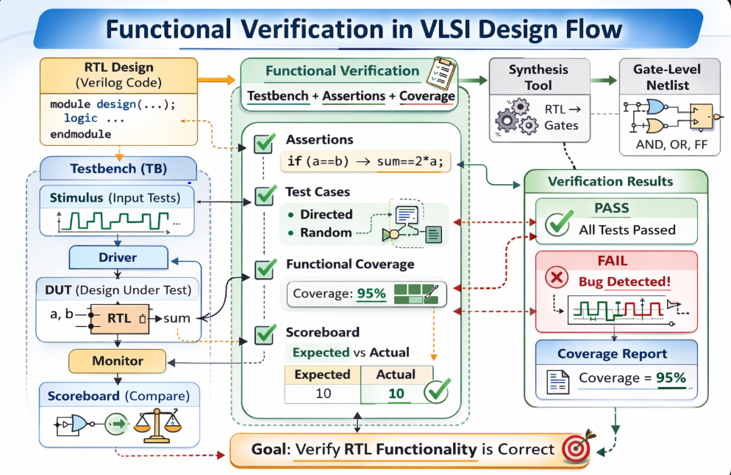
Functional verification (Our course)
Goal: Prove the Design Matches the Specification
Ensures RTL behaves exactly as defined in the system specification
Finds bugs before tapeout (when fixes are still cheap)
Uses simulation, assertions, and coverage to measure correctness

Slide 9
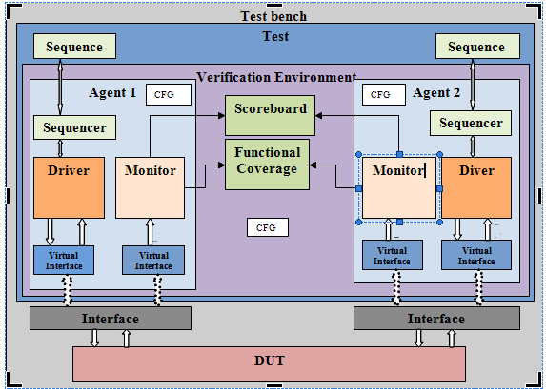
Functional verification (Our course)
Verification Environment Structure
DUT (Design Under Test) – your RTL Testbench – generates stimulus
Driver - converts high-level transaction objects into pin-level signal activity on the DUT interface
Monitor – observes DUT behavior
Scoreboard – checks correctness
Coverage – measures completeness

Slide 10
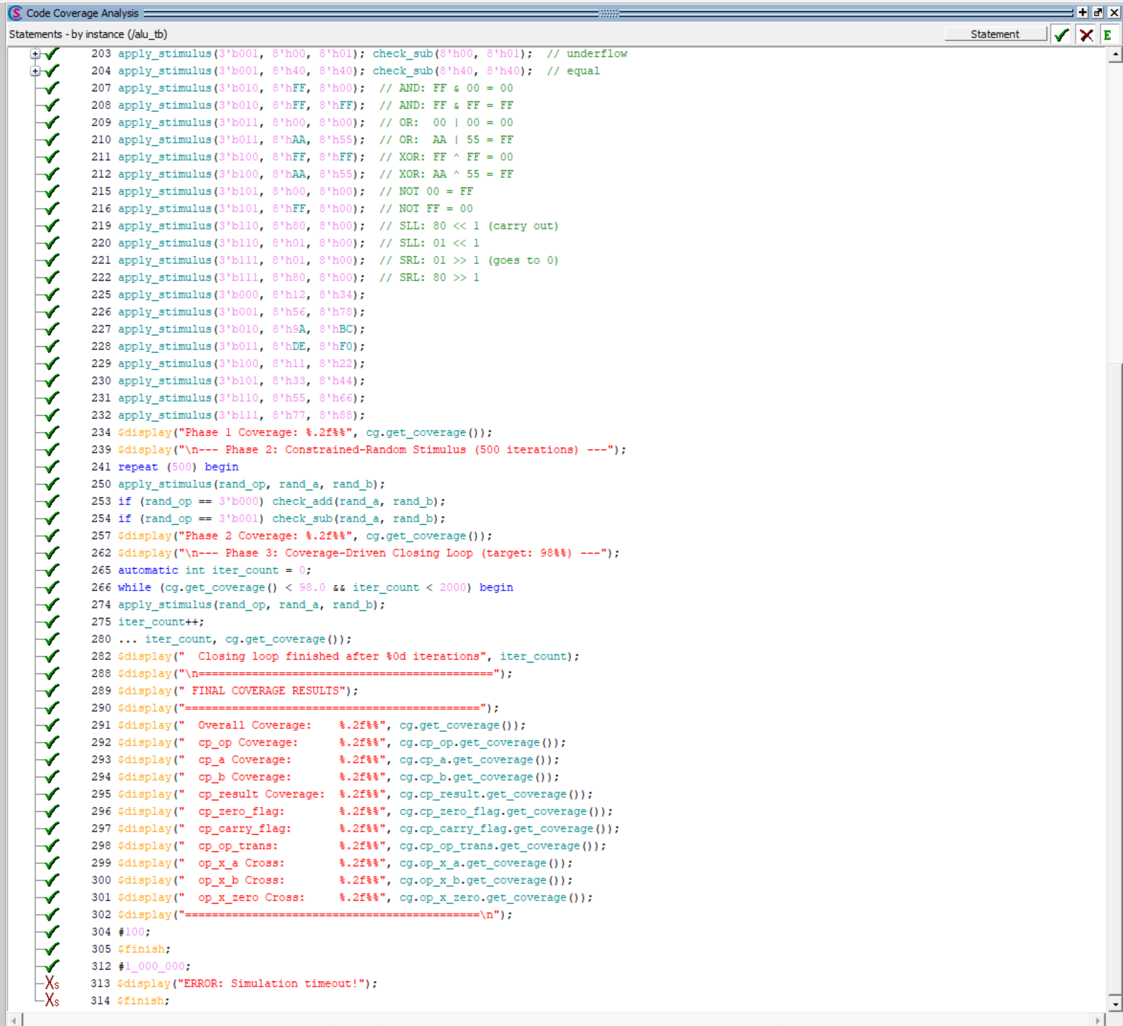
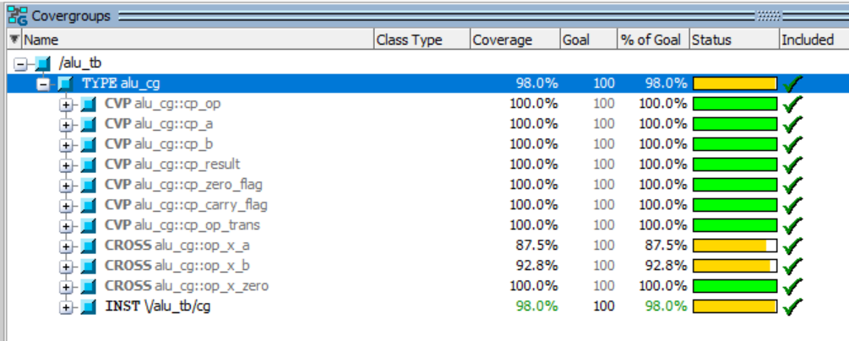
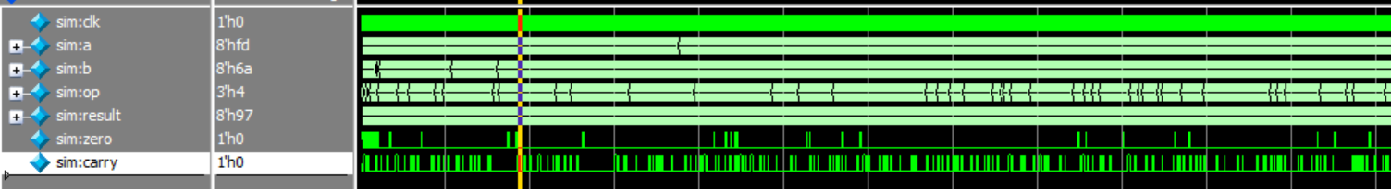
Functional verification (Our course)

Slide 11
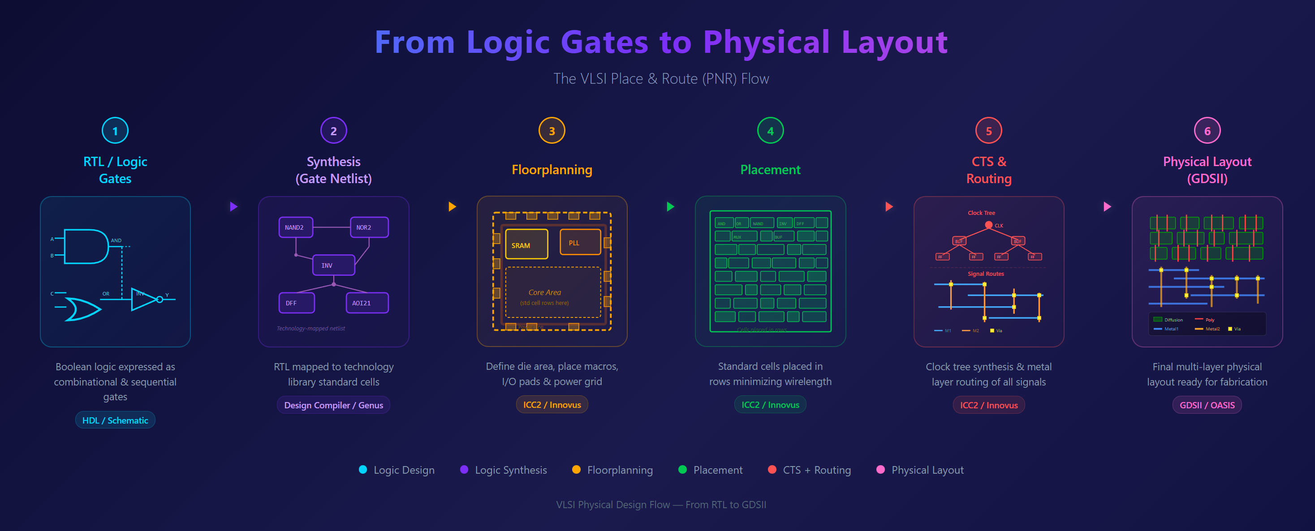
Physical design (PNR flow)
Transforms netlist into silicon layout — converts synthesized gates into placed cells, routed interconnects, and final GDSII ready for fabrication.
Ensures timing, power, and signal integrity — performs placement, Clock Tree Synthesis (CTS), routing, and timing closure using STA.
Final step before tapeout — validates DRC/LVS and manufacturability using EDA tools from companies like Synopsys and Cadence Design Systems.

Slide 12
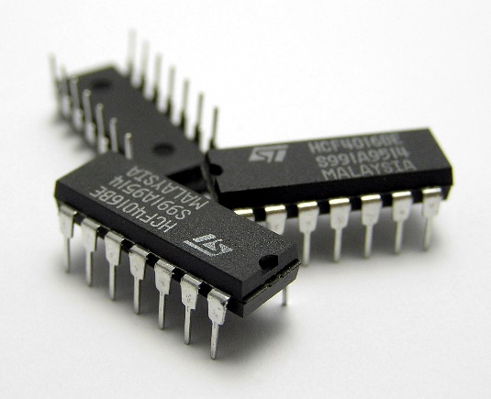
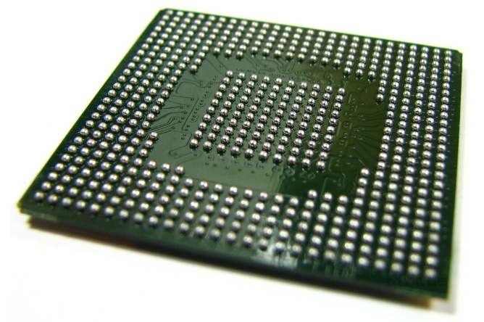
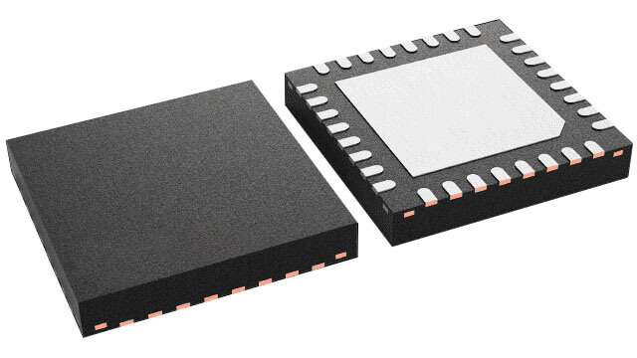
Packaging
DIP (Dual In-Line Package) – Through-hole package with two parallel rows of pins; easy to prototype and solder, commonly used in educational boards and legacy designs (e.g., Dual in-line package).
QFN (Quad Flat No-Lead) – Surface-mount package with no external leads; compact size, good thermal performance, widely used in consumer electronics (Quad Flat No-leads).
BGA (Ball Grid Array) – Uses solder balls arranged in a grid under the chip; supports high pin count and high-speed signals, common in processors and advanced SoCs (Ball grid array).

Slide 13
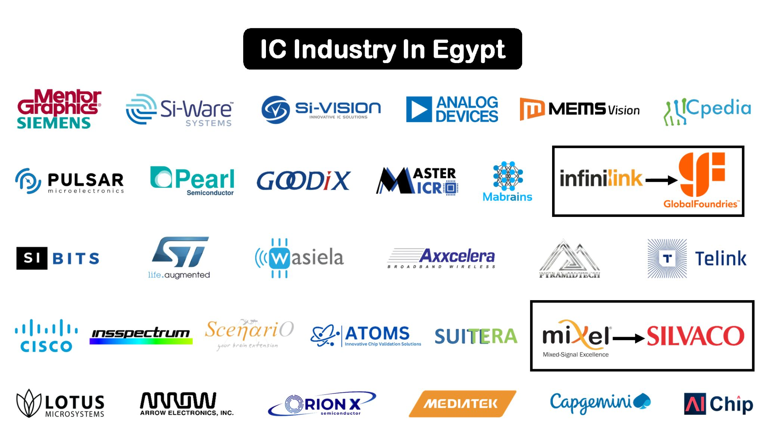
Market in Egypt

Slide 14
Types of companies in VLSI field
Fabless Semiconductor Companies – Design chips but outsource manufacturing to foundries.Examples: NVIDIA, Qualcomm, AMD.
Foundries (Fabrication Companies) – Manufacture chips designed by others.Examples: TSMC, GlobalFoundries.
IDMs (Integrated Device Manufacturers) – Design and manufacture their own chips.Examples: Intel, Samsung Electronics.
EDA Tool Companies – Provide design and verification software used to build chips.Examples: Synopsys, Cadence Design Systems, Siemens EDA.
IP Companies – Develop reusable design blocks (CPU cores, interfaces, PHYs).Example: Arm Holdings.

Slide 15
Types of companies in Egypt
Fabless Semiconductor Companies –Examples: Cisco, Mediatek, Pearl Semiconductor .
Foundries (Fabrication Companies).
IDMs (Integrated Device Manufacturers).
EDA Tool Companies –Examples: Siemens EDA, Master Micro.
IP Companies –Example: Mixel.
Salary range: 800$ - 1500$ for fresh grads

Slide 16
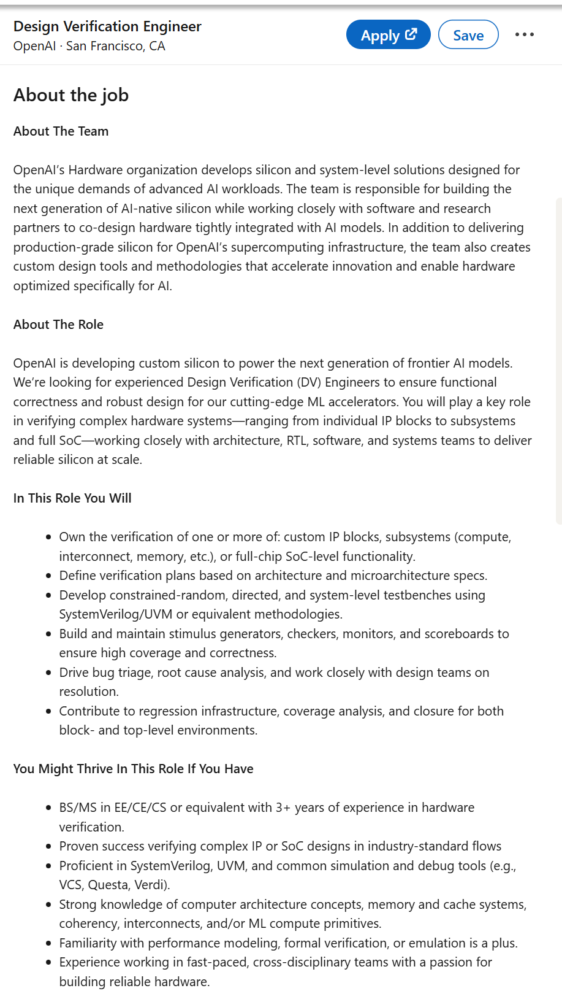
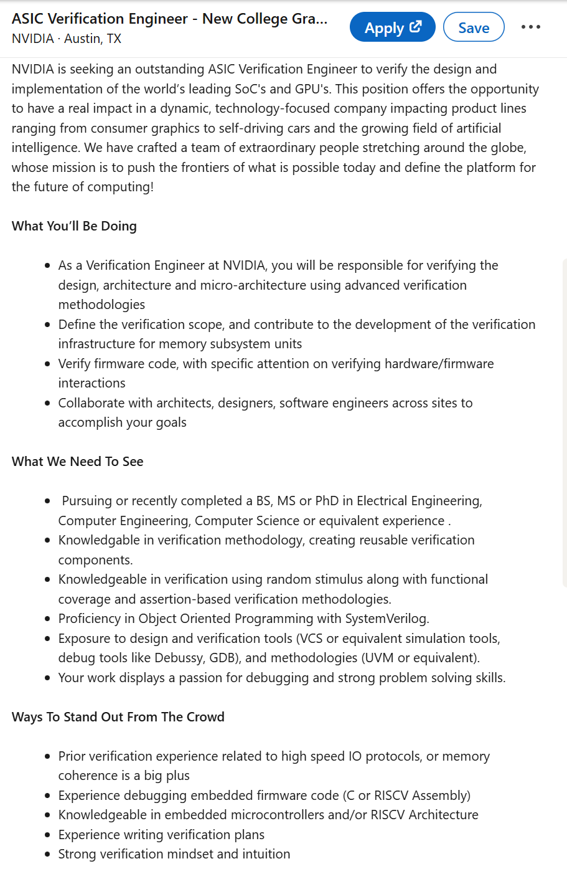
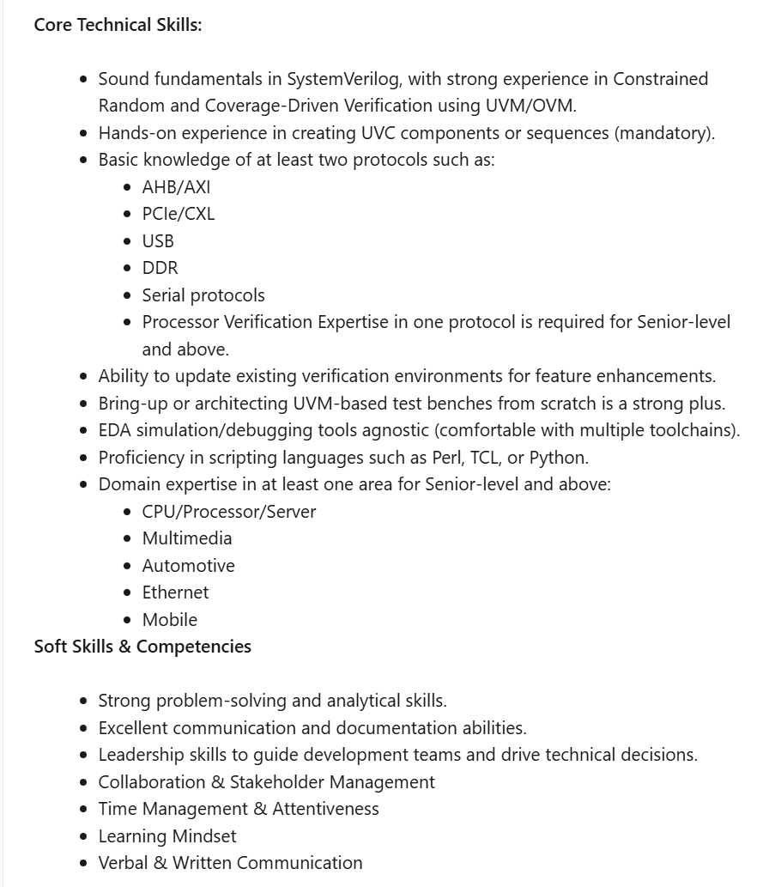
Required skills

Slide 17
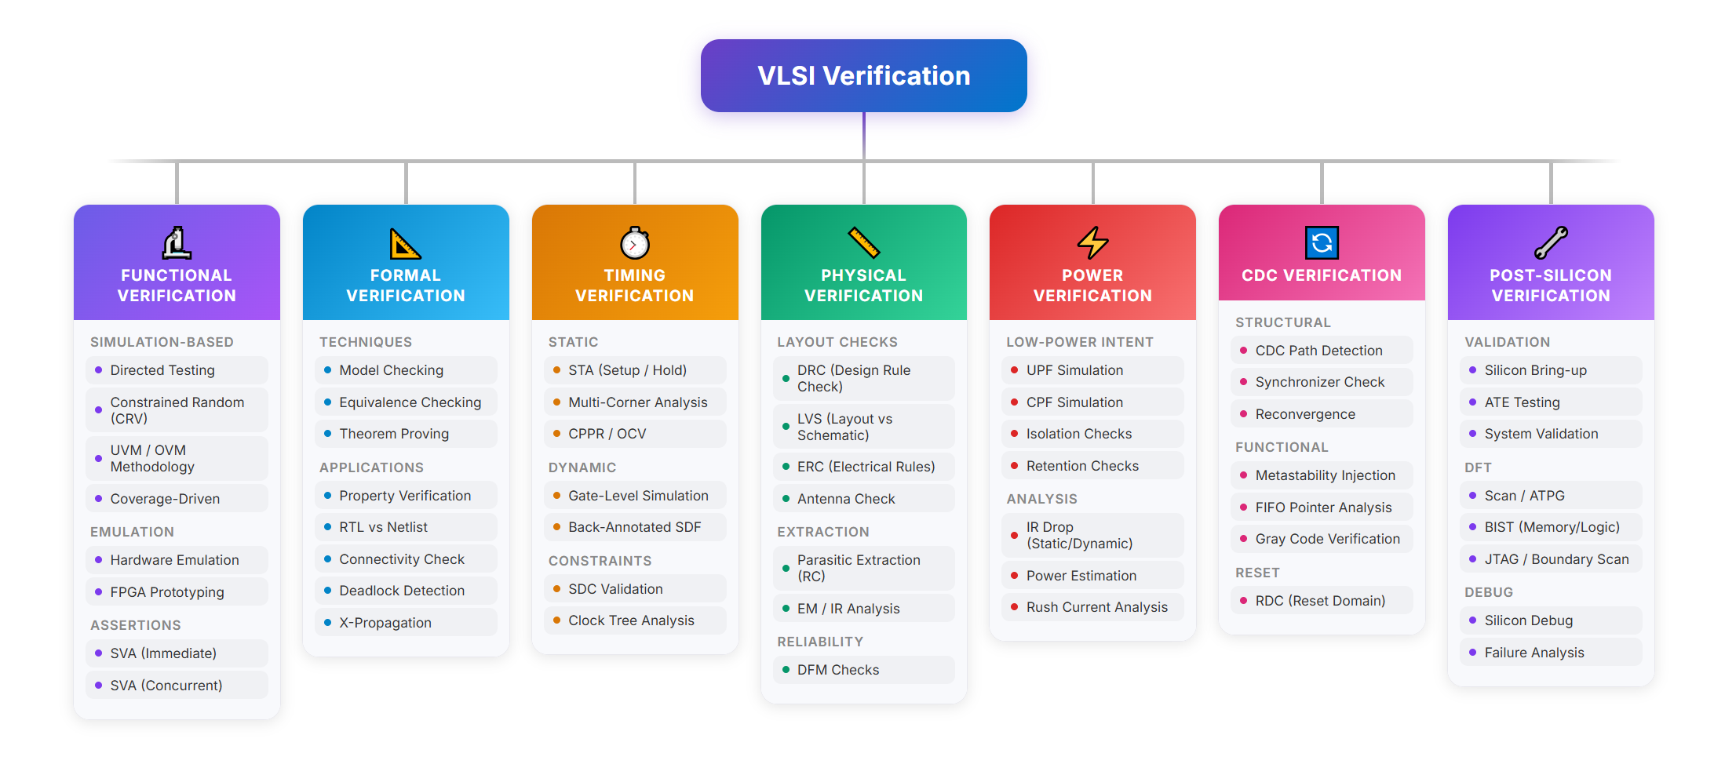
Types of verification

Slide 18
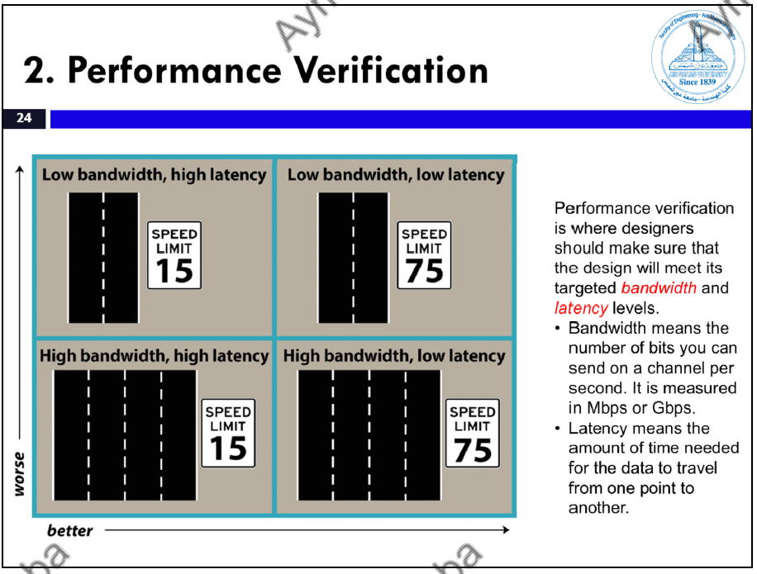

Slide 19
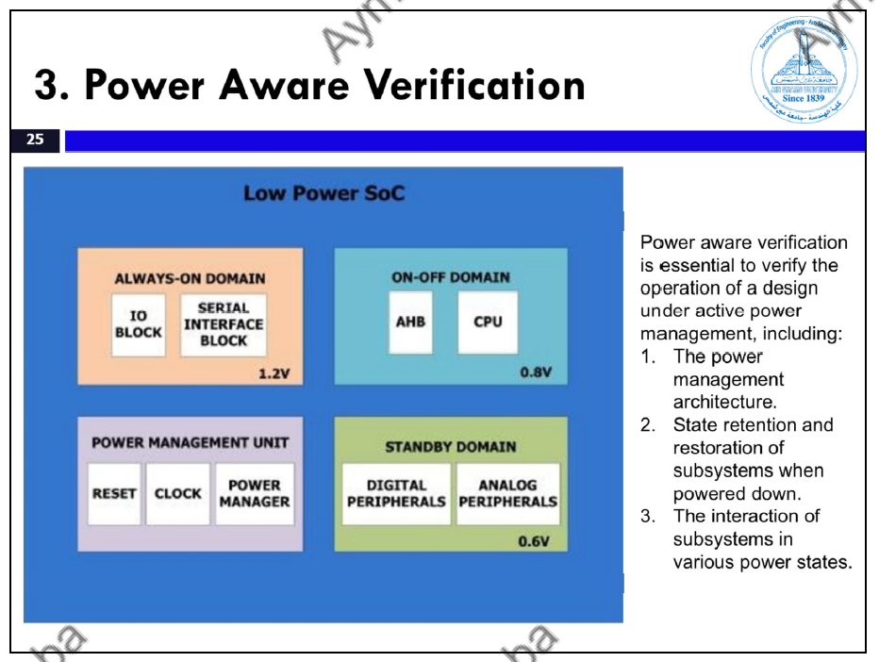

Slide 20
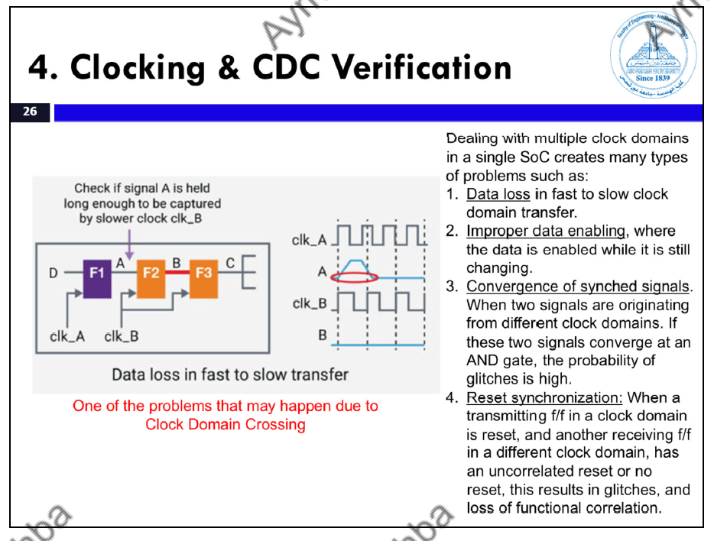

Slide 21
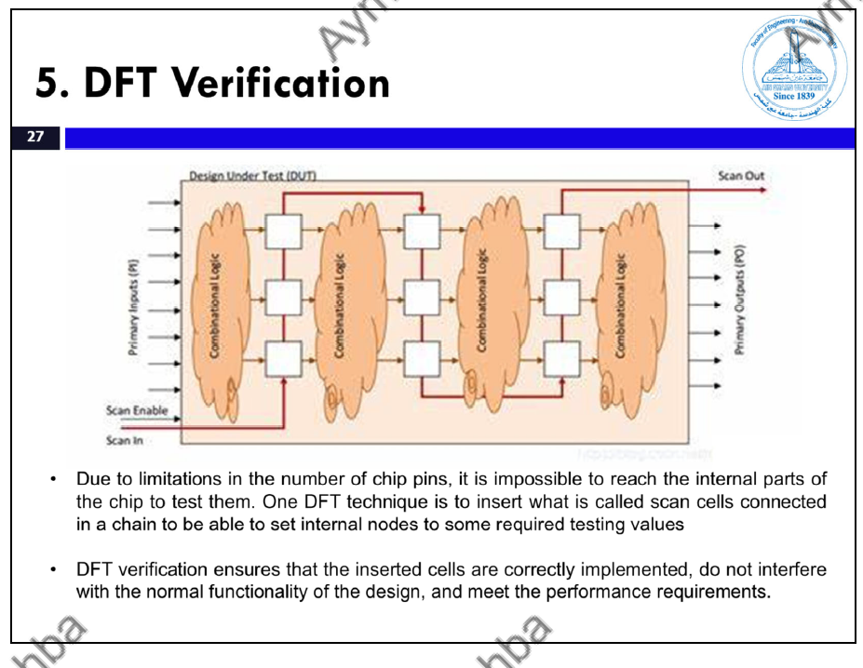

Slide 22
